Slide 1

Generative AI Prototype: Automotive Applications

Slide 2
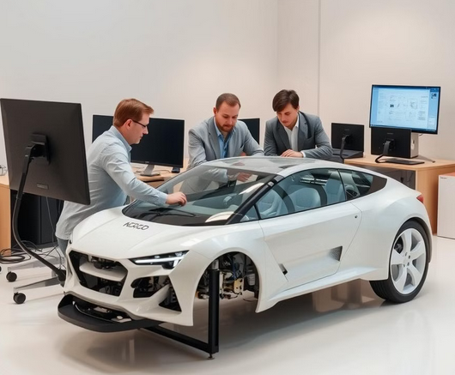
Step 1: Define the Scope for the Prototype
Personalized Driving Experience: Demonstrate how generative AI can adapt settings like seat position, climate, and music based on driver preferences.
Smarter Customer Support: Build a chatbot or voice assistant prototype that can respond to queries about car features, maintenance alerts, or troubleshooting.
Customized Entertainment: Use generative AI to recommend entertainment based on user preferences, mood, and journey type.

Slide 3

Step 2: Choose Tools and Technologies
Personalized Settings:
Data Collection: Mock or simulate user data (e.g., preferences for seat position, temperature).
Personalized Settings:
Machine Learning Model: Use simple supervised learning algorithms or clustering models to group preferences. Python libraries like scikit-learn can be helpful here.
Integration: Connect this with a front-end (e.g., a web interface) that shows how the settings adjust based on user profile. Generative Models: Use generative models like Stable Diffusion or GANs for design mockups. You could generate different car designs based on a given style or trend.
Prototype Interface: Create a small web interface that allows users to input design requirements and get generated visual outputs.
Conversational AI: Use tools like Dialogflow, Rasa, or OpenAI's GPT-4 API to develop a chatbot that can answer queries about maintenance, features, or troubleshooting.
Integration: Display the assistant’s responses within a simulated dashboard or app UI.
Recommendation System: Use a content-based recommendation model with scikit-learn or TensorFlow to suggest music or podcasts based on user preferences or mood.
Real-time Data Simulation: Collect or simulate data on trip type (long drive, city commute) and use it to refine the recommendations.

Slide 4
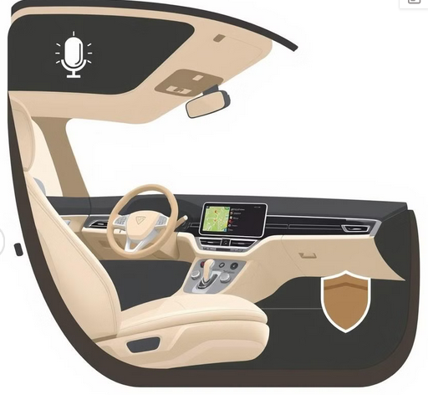
Step 3: Prototype Development
1. Front-End Mockup (UI/UX)
Use a tool like Figma or Adobe XD for a clickable prototype, or create a basic interactive UI using React or Flask to simulate in-car screens.
Design screens showing the car's adaptive capabilities (personalized settings, AI assistant, entertainment suggestions).
2. Back-End/Model Development
Build simple machine learning or rule-based algorithms to represent the personalized features.
For generative models (like car design), use pre-trained models if available, or showcase potential outputs if a model is too complex to train.
3. Integration and Simulation
Create a dashboard interface or simple app that simulates how each feature would look in action. For instance, a web app with different tabs representing "Personalized Settings," "AI Assistant," and "Entertainment Recommendations."

Slide 5

Step 4: Testing and Refinement
Will test prototype with a few people, such as friends or colleagues, to gather feedback on the flow, intuitiveness, and realism of the experience. Will refine the UI/UX and model outputs based on their feedback to ensure the prototype effectively demonstrates the concept. This process will help to make adjustments that improve the user experience and ensure the final prototype aligns well with real-world expectations.

